Slide 1
Structure
The Short Story

Slide 2

Turning point: the most intense moment
Rising Action: the series of conflicts and crises in the story that lead to the climax
Falling Action: all of the action which follows the turning point
Exposition: the start of the story, the situation before the action starts
Resolution: the conclusion, the tying together of all of the threads (or not!)
Notes:
Exposition: The mood and conditions existing at the beginning of the story. The setting is identified. The main characters with their positions, circumstances and relationships to one another are established. The exciting force or initial conflict is introduced. Sometimes called the “Narrative HOOK” this begins the conflict that continues throughout the story.
Rising Action: The series of events, conflicts, and crises in the story that lead up to the climax, providing the progressive intensity, and complicate the conflict.
Climax: The turning point of the story. A crucial event takes place and from this point forward, the protagonist moves toward his inevitable end. The event may be either an action or a mental decision that the protagonist makes.
Falling Action: The events occurring from the time of the climax to the end of the story. The main character may encounter more conflicts in this part of the story, but the end is inevitable.
Resolution/Denouement: The tying up of loose ends and all of the threads in the story. The conclusion. The hero character either emerges triumphant or is defeated at this point.

Slide 3
Exposition
No long explanations – situates the reader in the story.
Introduces the reader to the character or characters.
It explains the situation before the action starts - briefly.
‘When’ and ‘where’ of setting is explained.
At this stage, the reader needs to be ‘hooked’.

Slide 4
Rising Action
Conflicts or complications are introduced.
The reader’s interest needs to be held.
The action will lead up to the climax or turning point of the story.

Slide 5
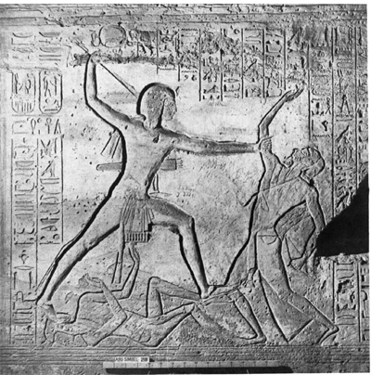
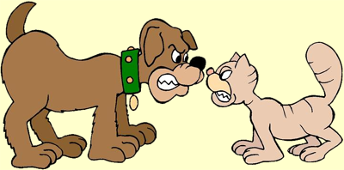
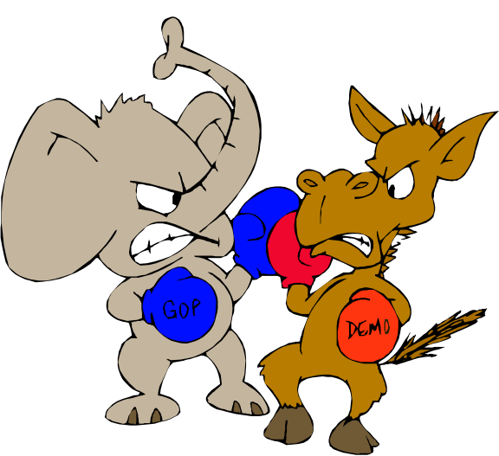
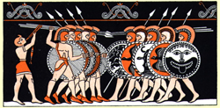
Conflict
Conflict is the dramatic struggle between two forces in a story. Without conflict, there is no plot.

Slide 6

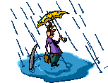
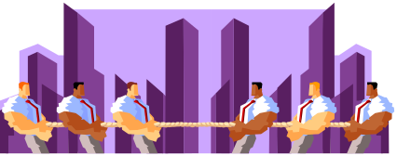

Types of Conflict
Human vs Human
Human vs Nature
Human vs Society
Human vs Self

Slide 7
Turning Point
This is the most intense point or event in the narrative.
Usually – but not always - just before all the problems get solved and the reader’s questions are answered.
Some resolutions ask the reader to provide an interpretation.

Slide 8
Falling Action
All of the action that follows the turning point.
Everything moves towards the ending.

Slide 9
Resolution
This is the conclusion – the problems are often resolved at this stage.
The reader’s questions are usually answered.
Loose ends are tied up (but not always!).

